Slide 1
History of Rocketry

Slide 2
China
You can delete this slide when you’re done editing the presentation
Fonts | To view this template correctly in PowerPoint, download and install the fonts we used
Used and alternative resources | An assortment of graphic resources that are suitable for use in this presentation
Thanks slide | You must keep it so that proper credits for our design are given
Colors | All the colors used in this presentation
Icons and infographic resources | These can be used in the template, and their size and color can be edited
Editable presentation theme | You can edit the master slides easily. For more info, click here
For more info: SLIDESGO | BLOG | FAQS
You can visit our sister projects: FREEPIK | FLATICON | STORYSET | WEPIK | VIDEVO

Slide 3
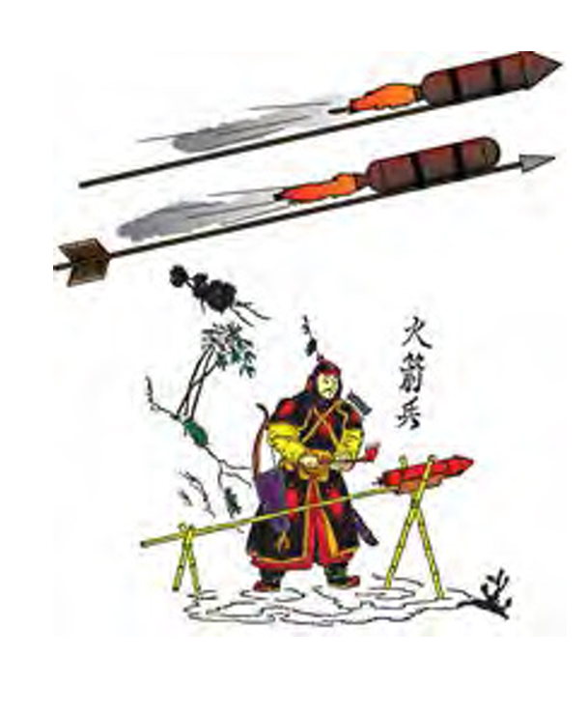
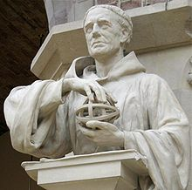
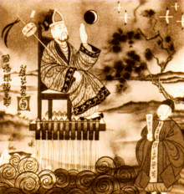
China, ca. 1232
Europe, ca. 1267
China, ca. 1290
The Chinese invented gunpowder and put it in tubes of bamboo, creating the first modern rocket.
Roger Bacon writes down the first European descriptions of gunpowder from a demonstration of Chinese firecrackers
According to legend, Wan Hu strapped 47 gunpowder rockets to a chair to try go to space.
Notes:
Chinese utilized the rockets in battle against the Mongols
Roger bacon is a monk and philosopher
After lighting the fuse, a huge explosion occurred. When the smoke cleared, Wan Hu was gone, with some believing he actually made it

Slide 4
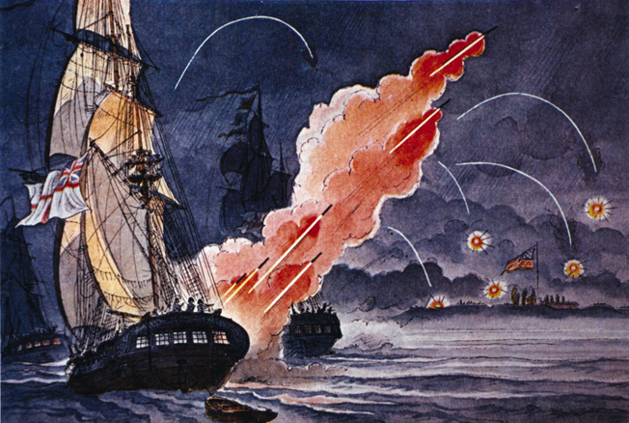
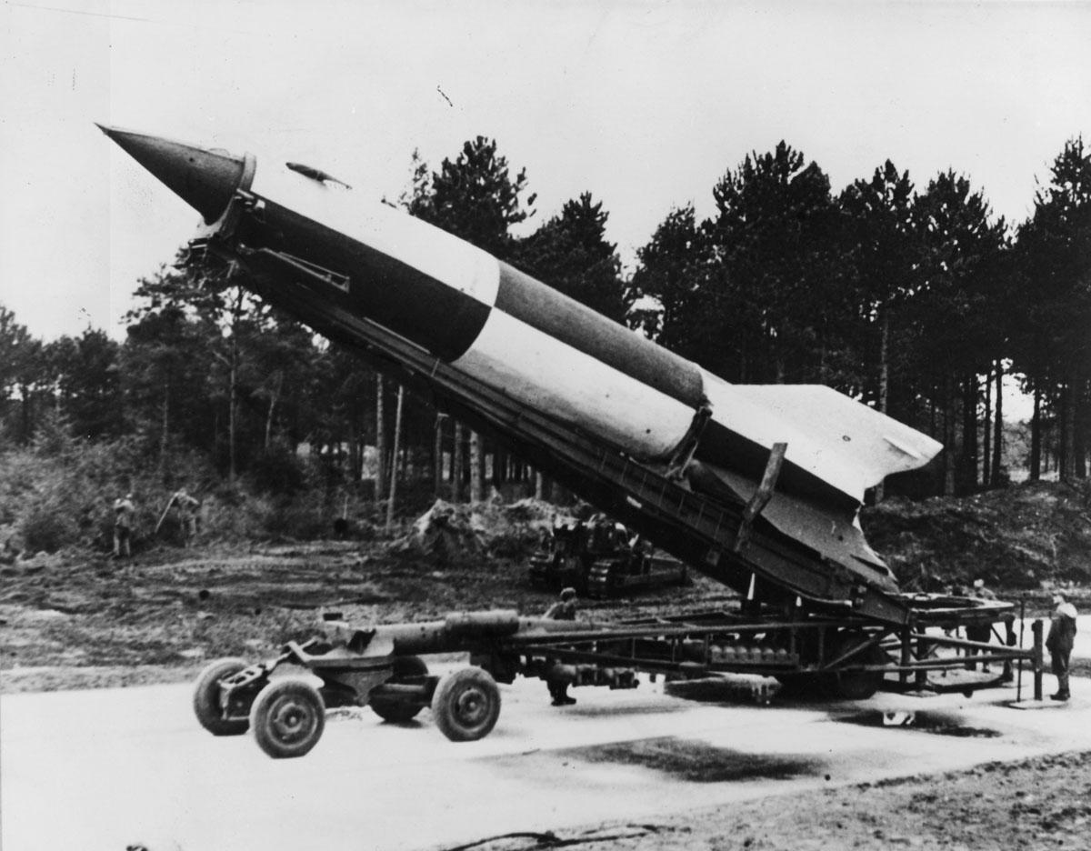
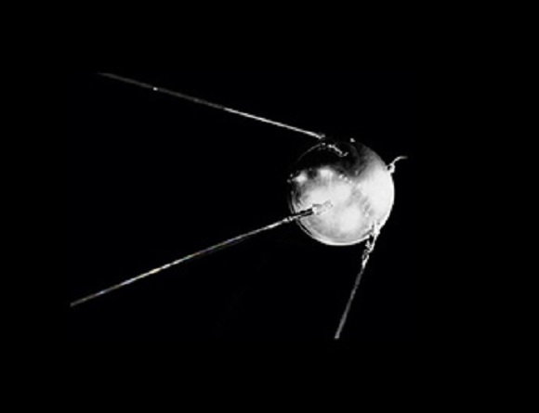
England, ca. 1800
Germany, ca. 1940
USSR, ca. 1957
Colonel William Congreve invents rockets with ranges up to 6,000 yards.
German scientists jumpstart the Space Age with their V2 rocket, which was used during WWII to bomb Britain.
The USSR wins the first round of the Space Race by launching the first satellite into space: Sputnik I.
Notes:
The phrase “by the rocket’s red glare” in the national anthem refers to Congreve rockets used in the War of 1812.
The V2 rockets had a range of 200 miles, a maximum altitude of 55 miles, and could deliver a 1 ton explosive warhead from Berlin to London
2 months after Sputnik I, Sputnik II carries the first living passenger to space – Laika, a dog who orbited Earth for a couple hours.

Slide 5
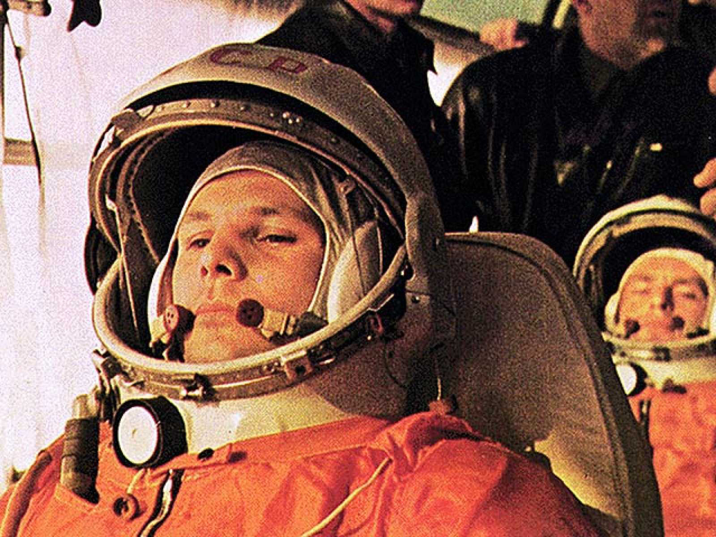
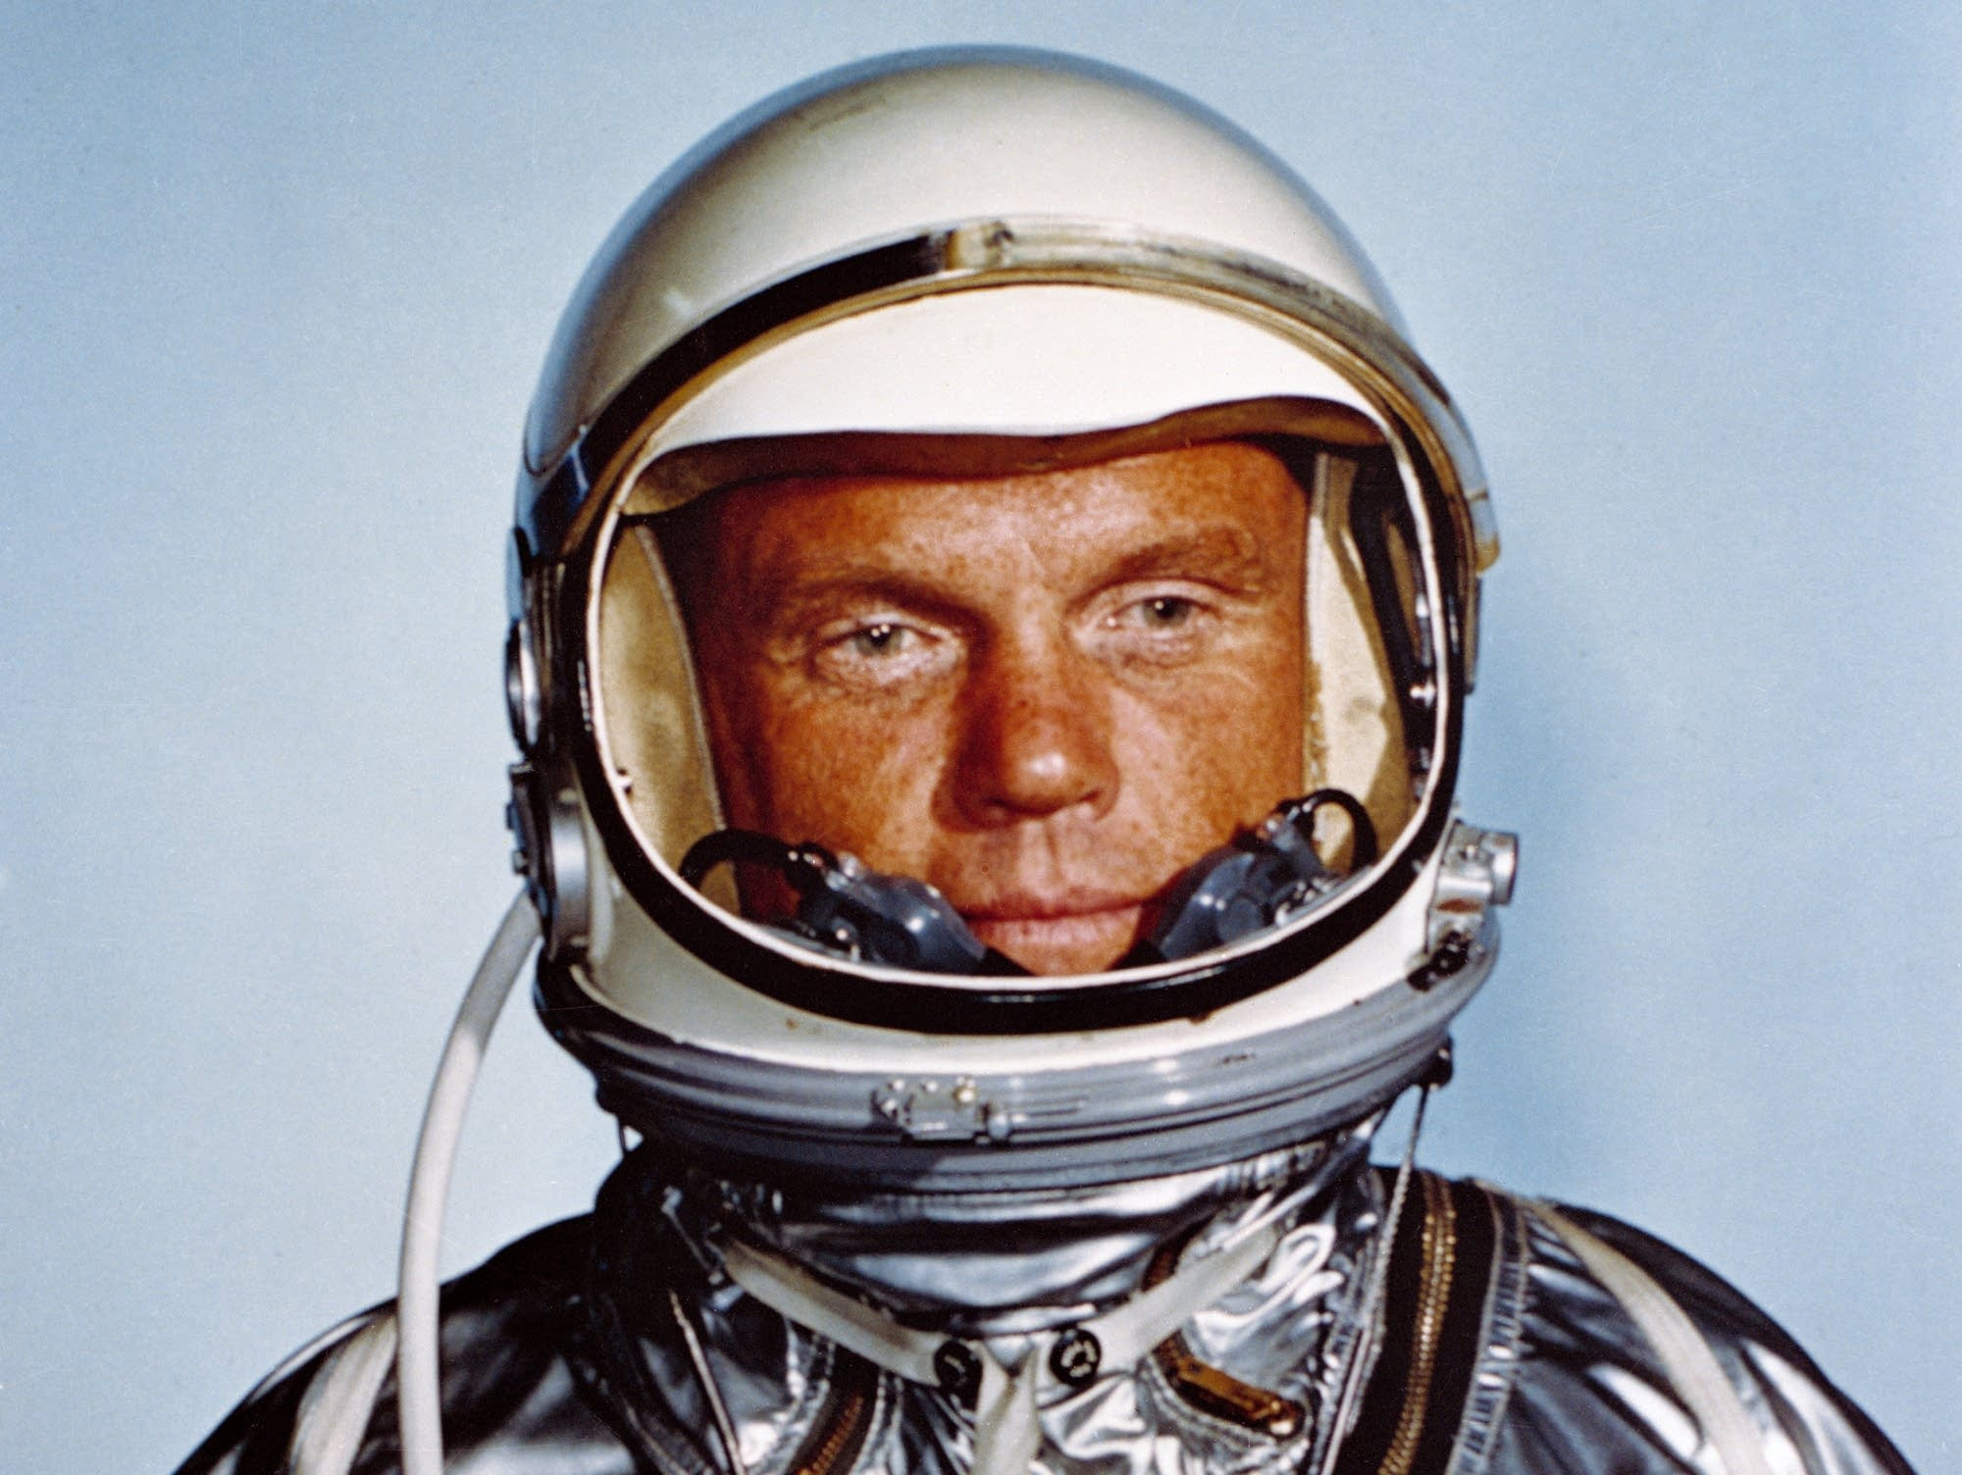
USSR, ca. 1961
US, ca. 1962
US, ca. 1969
Yuri Gagarin becomes the first man in space, orbiting the Earth one time over 1 hour 48 minutes.
John Glenn becomes the first American to orbit the Earth on the Atlas rocket
The USSR wins the first round of the Space Race by launching the first satellite into space: Sputnik I.
Notes:
Cosmonauts specifically refer to Russian astronauts
Glenn orbited the Earth 3 times for a total of 4 hours 55 minutes

Slide 6
Stability (spin, CG CP
01
02
03
OBSERVATORY
TELESCOPES
SATELLITES
You could describe the topic of the section here
You could describe the topic of the section here
You could describe the topic of the section here

Slide 7
OBSERVE CELESTIAL OBJECTS
Mercury is the closest planet to the Sun and the smallest one in the entire Solar System. This planet's name has nothing to do with the liquid metal, since Mercury was named after the Roman messenger god.
Despite being closer to the Sun than Venus, its temperatures aren't as hot as that planet's.
Mercury takes a little more than 58 days to complete its rotation, so try to imagine how long days must be there!
Since the temperatures are so extreme, albeit not as extreme as in Venus, and the solar radiation is so high, Mercury has been deemed to be non-habitable for humans

Slide 8
ELECTROMAGNETIC SPECTRUM
Do you know what helps you make your point clear? Lists like this one:
They’re simple
You can organize your ideas clearly
You’ll never forget to buy milk!
And the most important thing: the audience won’t miss the point of your presentation

Slide 9
OUR OPTICAL OBSERVATORIES
A
B
MERCURY
VENUS
Mercury is the closest planet and the smallest one in the Solar System
Venus has a beautiful name and is the second planet from the Sun

Slide 10
COSMIC RADIO WAVE EMITTERS
MARS
JUPITER
MERCURY
Despite being red, Mars is actually a very cold place
Jupiter is a gas giant and the biggest in the Solar System
It’s the closest planet to the Sun and the smallest one

